Slide 1


ITALIAN AIRFORCE
AVIATION ENGLISH TRAINING CENTER
STUDENT-CENTERED TEACHING
ITAF LANGUAGE SCHOOL CASE STUDY
COL. STEFANO GENSINI
08 OCTOBER 2015

Slide 2

AGENDA
LEARNING THEORIES OVERVIEW
STUDENT-CENTERED APPROACH
ITAF LANGUAGE SCHOOL
CONCLUSIONS
ITALIAN AIRFORCE
2/30

Slide 3
AGENDA
LEARNING THEORIES OVERVIEW
STUDENT CENTERED APPROACH
ITAF LANGUAGE SCHOOL
CONCLUSIONS
ITALIAN AIRFORCE
3/30

Slide 4
INTRODUCTION
SCHOOLS
TO MAXIMISE HUMAN POTENTIAL
TO THINK DIFFERENTLY
TO DEVELOP MULTIPLE PERSPECTIVES
ITALIAN AIRFORCE
4/30

Slide 5

LEARNING THEORIES OVERVIEW
METHODS
LEARNING
STYLES
SPEEDS
ITALIAN AIRFORCE
5/30

Slide 6
LEARNING THEORIES OVERVIEW
METHODS
STYLES
SCHOOLS
SPEEDS
ITALIAN AIRFORCE
6/30

Slide 7
LEARNING THEORIES OVERVIEW
METHODS
STANDARD
STYLES
SCHOOLS
SPEEDS
ITALIAN AIRFORCE
7/30

Slide 8
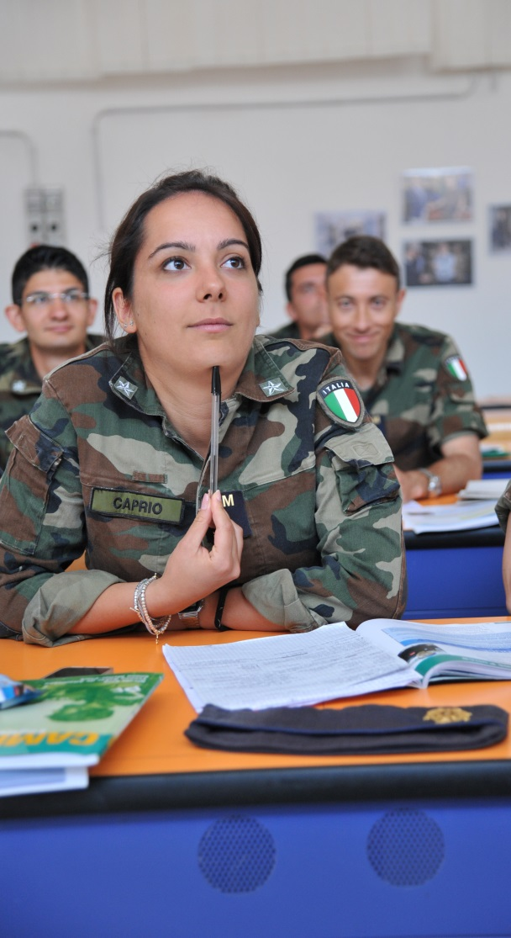
LEARNING THEORIES OVERVIEW
SCI
STUDENT ENGAGEMENT
IMMERSION
PERSONAL RESPONSABILITY
ITALIAN AIRFORCE
8/30

Slide 9
LEARNING THEORIES OVERVIEW
STUDENT SELF RELIANCE
PROBLEM SOLVING
ROLE PLAYING
TEAM PROJECTS
INDIVIDUAL ASSIGNEMENTS
ITALIAN AIRFORCE
9/30

Slide 10
AGENDA
LEARNING THEORIES OVERVIEW
STUDENT CENTERED APPROACH
ITAF LANGUAGE SCHOOL
CONCLUSIONS
ITALIAN AIRFORCE
10/30

Slide 11
STUDENT-CENTERED APPROACH
EDUCATIONAL PROGRAMS
LEARNING EXPERIENCE
INSTRUCTIONAL APPROACHES
ACADEMIC SUPPORT SPECIALISTS
EDUCATIONAL METHODS
ITALIAN AIRFORCE
11/30

Slide 12
STUDENT CENTERED APPROACH
EDUCATIONAL PROGRAMS
LEARNING EXPERIENCE
INSTRUCTIONAL APPROACHES
ACADEMIC SUPPORT STRATEGIES
EDUCATIONAL METHODS
ITALIAN AIRFORCE
12/30

Slide 13
STUDENT CENTERED APPROACH
TRADITIONAL ACADEMIC SETTINGS
INTERACTION
COURSE
LEARNING
EXPERIENCES
NON
TRADITIONAL ACADEMIC SETTINGS
PROGRAM
EXPERIENCE
ITALIAN AIRFORCE
13/30

Slide 14
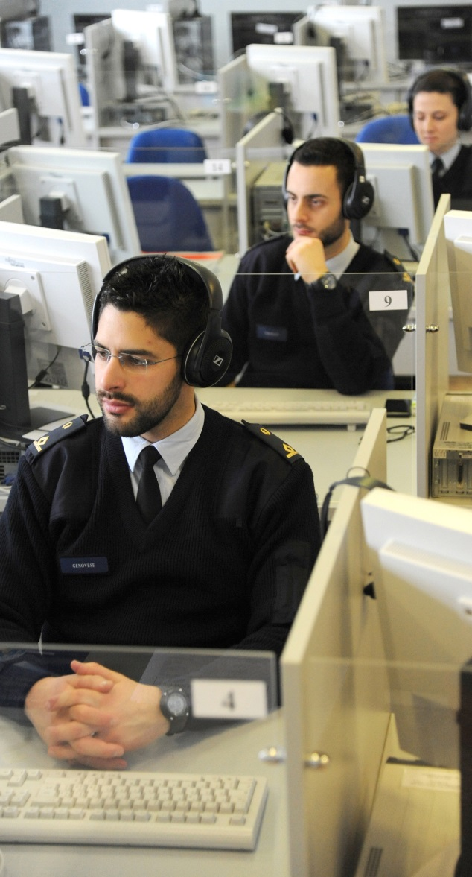
STUDENT CENTERED APPROACH
EMAIL
CHAT
VIDEO
LEARNING
EXPERIENCES
SOFTWARE
APPs
GAMES
ITALIAN AIRFORCE
14/30

Slide 15
STUDENT CENTERED APPROACH
CLASSROOM STRATEGIES
SCHOOL BASED STRATEGIES
ACADEMIC
SUPPORT
AFTER HOURS STRATEGIES
OUTSIDE SCHOOL STRATEGIES
TECHNOL. ASSISTED STRATs
ITALIAN AIRFORCE
15/30

Slide 16

STUDENT CENTERED APPROACH
PERSONALIZED TEACHING AND LEARNING
STUDENT LEARNING «ANYTIME – ANYWERE»
ITALIAN AIRFORCE
16/30

Slide 17
AGENDA
LEARNING THEORIES OVERVIEW
STUDENT CENTERED APPROACH
ITAF LANGUAGE SCHOOL
CONCLUSIONS
ITALIAN AIRFORCE
17/30

Slide 18
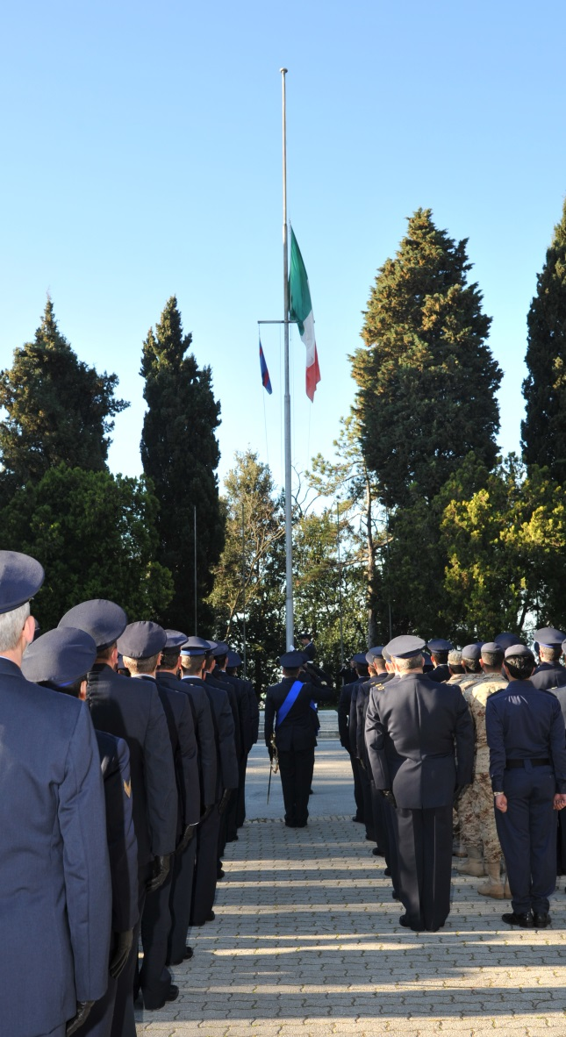
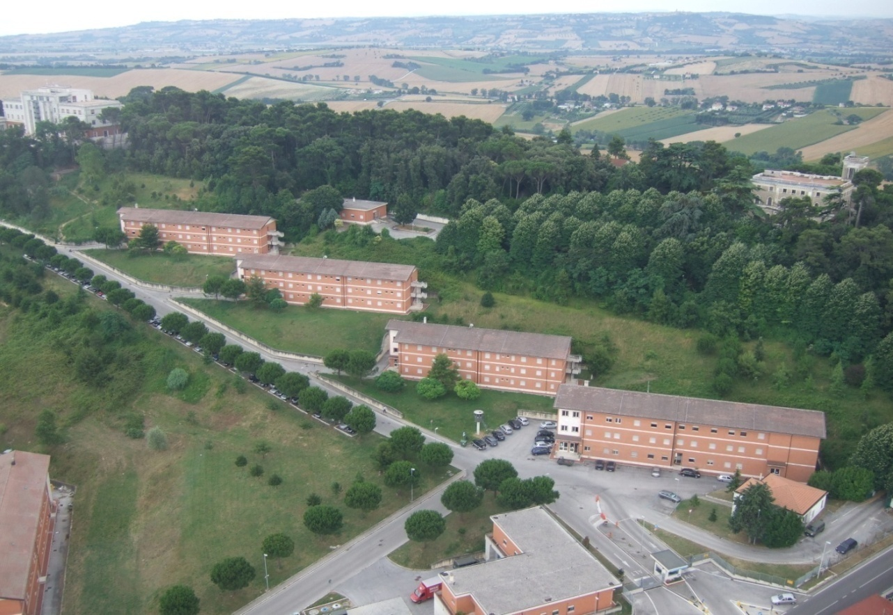
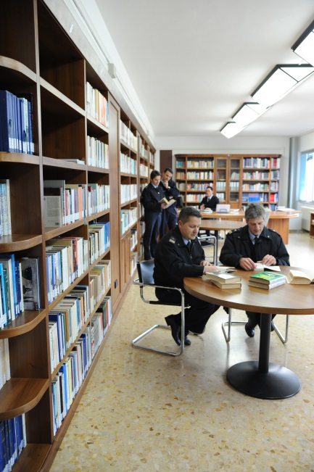


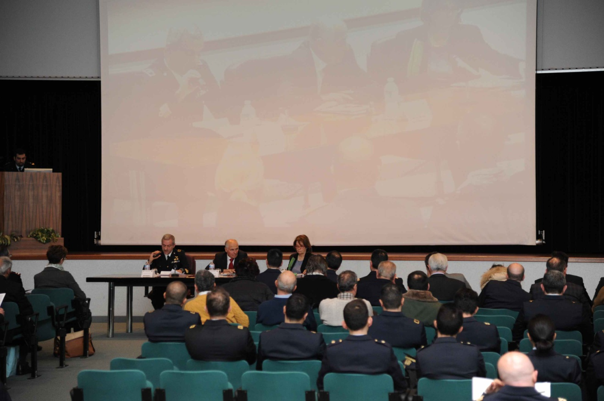
ITAF LANGUAGE SCHOOL
ITALIAN AIRFORCE
18/30

Slide 19
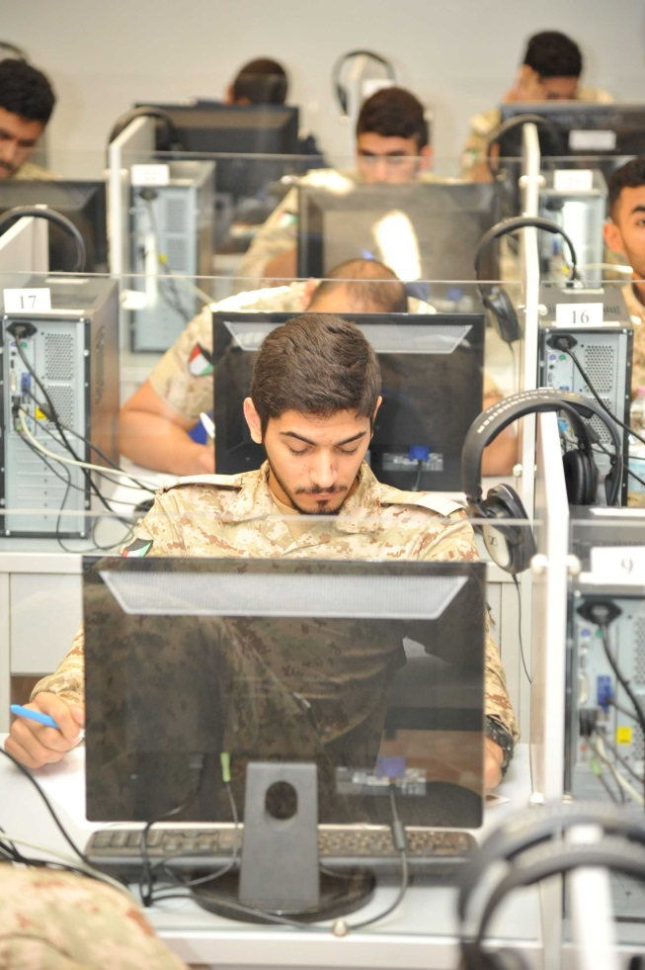
ITAF LANGUAGE SCHOOL
TEACHER-CENTERED STUDY APPROACH
LANGUAGE COURSES
STARTER
E-LEARNING
ELEMENTARY
PRE-INTERMEDIATE
INTERMEDIATE
RESIDENT
UPPER-INTERMEDIATE
ADVANCED
ITALIAN AIRFORCE
19/30

Slide 20
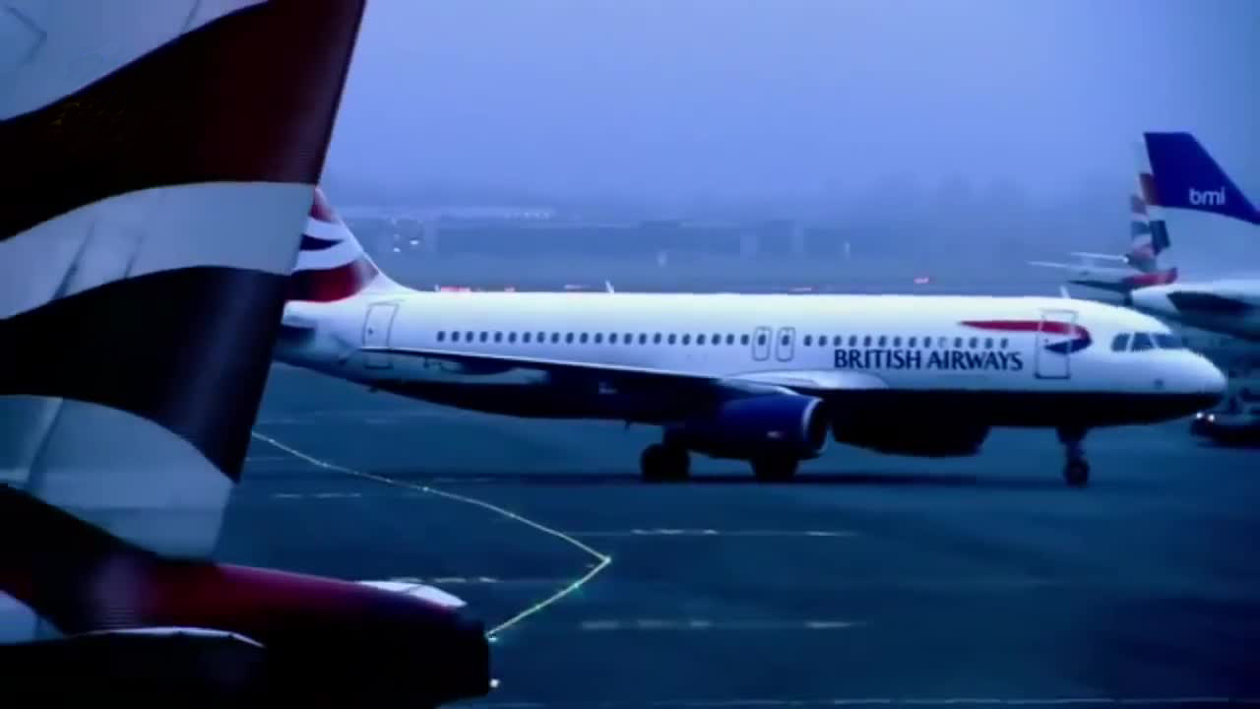
ITAF LANGUAGE SCHOOL
TEACHER-CENTERED STUDY APPROACH
AVIATION ENGLISH COURSES
- ICAO -
GUIDELINES FOR AVIATION ENGLISH TRAINING PROGRAMME
ITALIAN AIRFORCE
20/30

Slide 21
ITAF LANGUAGE SCHOOL
TEACHING TOOLS
DISCUSSION GROUPS
ONE-MINUTE PAPERS
CASE STUDIES
CONCEPT MAPPING
TUTORIAL WORKSHEETS
PROBLEM SOLVING
ITALIAN AIRFORCE
21/30

Slide 22
ITAF LANGUAGE SCHOOL
WORKING DAY PERIODS
TEACHER
CENTERED
STUDY
APPROACH
STUDENT
CENTERED
STUDY
APPROACH
08.00
13.30
14.30
16.30
ITALIAN AIRFORCE
22/30

Slide 23
ITAF LANGUAGE SCHOOL
TEACHER CENTERED STUDY APPROACH
AVIATION ENGLISH COURSES
INTERMEDIATE
RESIDENT
UPPER-INTERMEDIATE
ADVANCED
ITALIAN AIRFORCE
23/30

Slide 24
ITAF LANGUAGE SCHOOL
TEACHER-CENTERED STUDY APPROACH
AVIATION ENGLISH COURSES
INTERMEDIATE
RESIDENT
UPPER-INTERMEDIATE
ADVANCED
PILOTS
ATC
MAINTENANCE
ITALIAN AIRFORCE
24/30

Slide 25
ITAF LANGUAGE SCHOOL
STUDENT-CENTERED STUDY APPROACH
AIRSPACE
AIRPORTS
INFORMATION EXCHANGE
AVIATION
ENGLISH
OPERATIONAL
ENVIRONMENT
OPERATIONAL AWARNESS
ROUTINE
SITUATIONS
EMERGENCY
SITUATIONS
ITALIAN AIRFORCE
25/30

Slide 26
ITAF LANGUAGE SCHOOL
STUDENT-CENTERED STUDY APPROACH
E-READERS
DOCUMENTARIES
AVIATION
ENGLISH
TOOLS
DOCUMENTS
MEETING ROOMS
IPADS
ROLE GAMES
ITALIAN AIRFORCE
26/30
Notes:
WE ARE ENGINNNERING THESE TOOLS

Slide 27
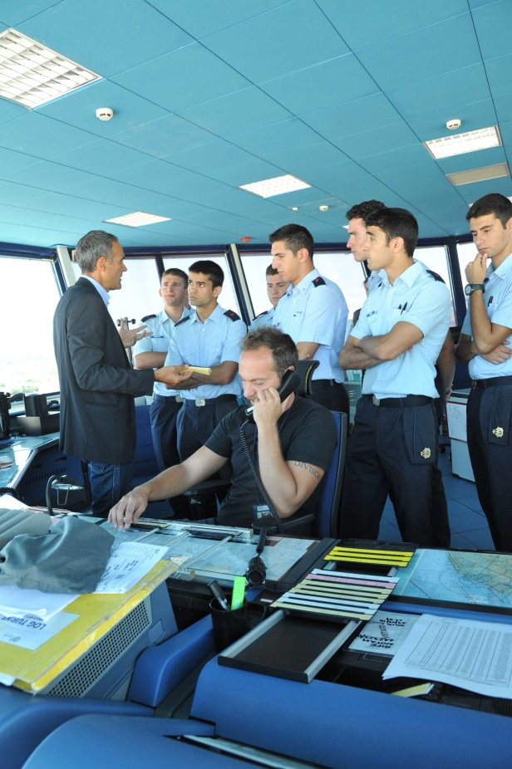
ITAF LANGUAGE SCHOOL
STUDENT-CENTERED STUDY APPROACH
TOOLS
REAL EXERCISE
ITALIAN AIRFORCE
27/30

Slide 28
AGENDA
LEARNING THEORIES OVERVIEW
STUDENT CENTERED APPROACH
ITAF LANGUAGE SCHOOL
CONCLUSIONS
ITALIAN AIRFORCE
28/30

Slide 29
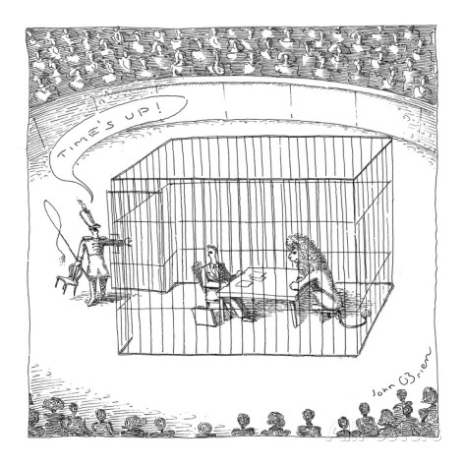
TAMING THE CHANGE
ITALIAN AIRFORCE
29/30

Slide 30
TAMING THE CHANGE
MODERNIZED TEACHING
INTERNATIONAL OFFER
GLOBAL NETWORKING
ITALIAN AIRFORCE
30/30

Slide 31
QUESTIONS ?
ITALIAN AIRFORCE

